Slide 1


Inspecting a Disposable Set

Slide 2
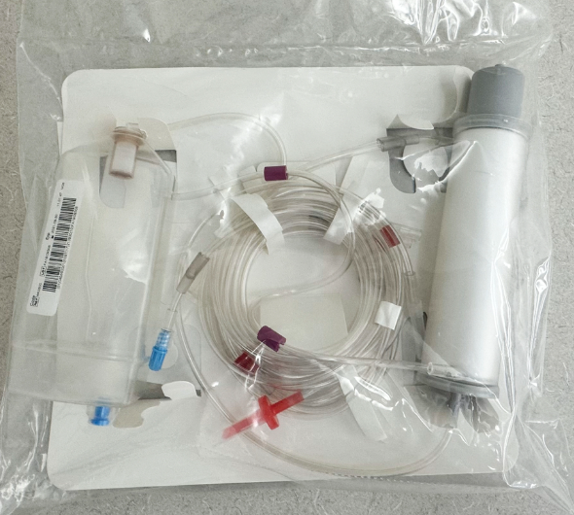
Welcome
In this lesson, you’ll learn how to:
Discuss the importance of inspecting the disposable set before installation on the Aurora Xi plasmapheresis device
Identify and describe the components of the disposable set
Explain how to inspect the disposable set for defects before use
Recognize soft goods defects
Verbalize the action to take if disposable set defects are noted at any point during the process

Slide 3
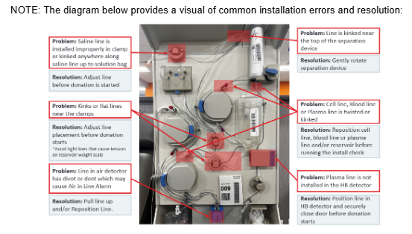
Your SOPs: An Introduction
These documents are the standard SOPs for inspecting and installing the disposable kit:
SOP-247014 Aurora Xi Set Installation, Check and Priming of Solutions
SOP-232626 NexSys PCS Disposable Set Installation and Spiking Solutions
A sample from SOP-247014:

Slide 4
Three Steps
The following steps comprise the disposable set workflow.
Step1: Inspecting a Disposable Set
Step 2: Installing a Disposable Set
Step 3 Hanging and Priming Solutions

Slide 5

Video: Introduction to Set Installation and Spiking Solutions

Slide 6


Learn About It
Complete the following web-based training lesson:
Inspecting a Disposable Set: NexSys

Slide 7

What Did You Learn?
What are the main components in the disposable kit?
Bowl
Harness//DPM filter/tubing
Plasma collection container
What are some of the defects or conditions in disposable sets that make them unusable?
Tubing has kinks or flat spots.
Protective caps are loose or missing.
Components are discolored or contaminated.
Components have been mishandled in a way that compromises sterility.

Slide 8
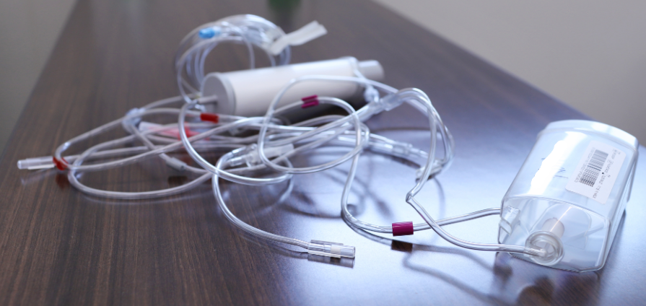
Activity: Would You Use This Kit?
Checklist: What should you look for?
Components
Defects
Sterility

Slide 9

References
Aurora Xi OR NexSys Operator’s Manual
SOP-247014 Aurora Xi Set Installation, Check and Priming of Solutions
SOP-232626 NexSys PCS Disposable Set Installation

Slide 10
What Did You Learn?

Slide 11

Summary
Always inspect the disposable kit before installation.
The kit contains these components:
    Bowl
    Harness/DPM filter/tubing
    Plasma collection container
Working with the disposable kit is a procedure with three parts: inspecting, installing, and hanging and priming solutions.
The disposable kit shouldn’t be used if you see physical defects or if the sterility of any component has been compromised.
If you do note any defects or if the sterility has been compromised, dispose of the kit and use a new one.

